Slide 1
Crime trends in select American cities
Impact of COVID 19 on Crime in America

Slide 2
Executive summary
Scope of the Study and Summary Findings
Angela Banko
Ashely Drewry
Dave Moorman
Todd Schanzlin

Slide 3
Our Study
Our team evaluated crime trends across six major metropolitan areas in the United States for which relatively standardized crime reporting statistics were available. The team looked at the following US Cities:
Denver
Seattle
San Francisco
Los Angeles
Philadelphia
Washington DC
For each city, we looked at monthly crime statistics categorized by:
Violent vs. non-violent
Offense category
Our goal was to determine whether there was any correlation between the outbreak of COVID-19 and crime trends in those cities for which we were able to pull data
Our analysis includes the following:
Correlation of COVID-19 reported cases vs. crime trends overall and for each city using scatter plots and regression analysis
For selected cities, a review of:
Crimes by offense
Violent vs. Non-Violent Crimes
Monthly crime trends

Slide 4
Crime Reporting and Classification
While the data sets for each city were similar, the crime offense codes vary by city. Thus for our correlation of crime trends with COVID-19, we focused on correlation with violent and non-violent crimes
The team manually coded violent and non-violent crime offenses based on the following general guidelines:
Non-Violent Crimes – Most often classified as “Property Crimes”:
Theft, larceny embezzlement, receipt of stolen goods, and arson
Contract crimes, fraud, tax crimes, and other forms of white collar crimes
Drug and alcohol-related crimes
Prostitution
Racketeering and gambling
Bribery
Traffic offenses
Violent Crimes – Most often classified as “offenses against the Person”:
Assault and battery
Homicides
Domestic violence
Robbery
Sexual assault and abuse
False imprisonment

Slide 5
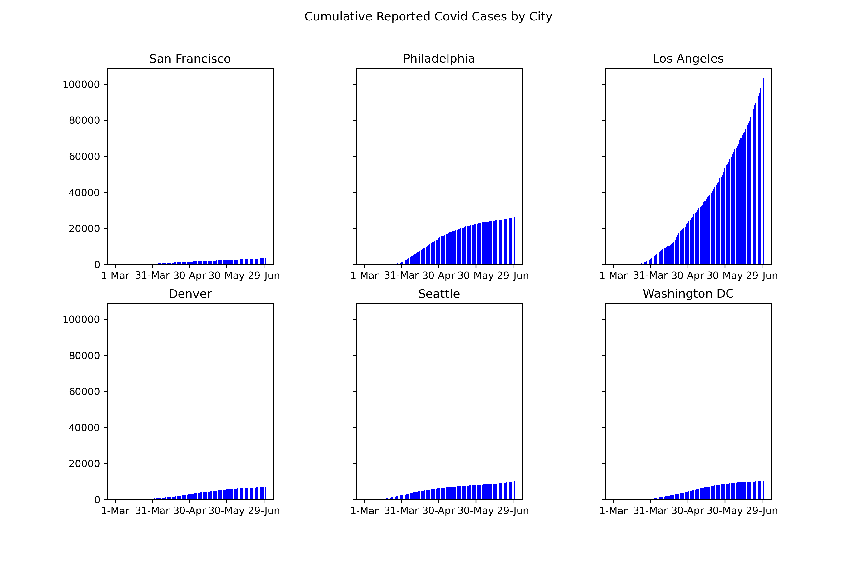
Reported Covid Cases in Selected Cities
Data through 6/30/2020
Top Outbreaks:
Los Angeles
Philadelphia
With the exception of Los Angeles, all of our target cities appear to have been able to “flatten the curve”
As Los Angeles has experienced the highest number of cases, which also appear to be accelerating, any correlation between Covid and crime should be more apparent in LA

Slide 6
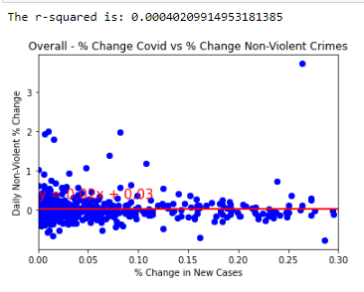
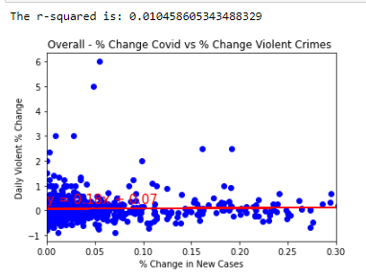
Correlation of Non-violent and Violent Crimes – All Cities
Overall, we found no correlation between COVID-19 and non-violent and violent crime trends
Analysis looks at the percent change in daily COVID cases across all cities vs. daily % change in non-violent and violent crimes from March 1 through June 30
Both data sets show a very low r-squared value as well as a nearly flat increase in reported crime cases regardless of the daily change in case counts

Slide 7
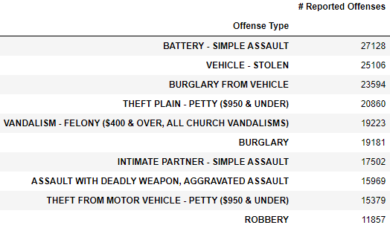
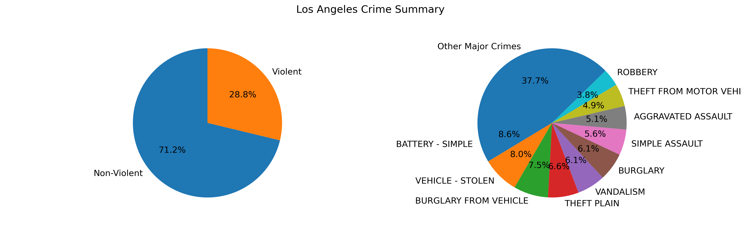
Los Angeles – Overview of Crime by Offense
Los Angeles represented the city with the highest rate of violent crimes in our city sample, with nearly 29% of all reported crimes classified as Violent
Other sample cities violent crime rates ranged between 12% and 26%
Violent crimes represent four of the top 10 reported crimes
Top violent crimes include Battery – Simple Assault, Intimate Partner, Simple Assault, Assault with a Deadly Weapon, and Robbery

Slide 8
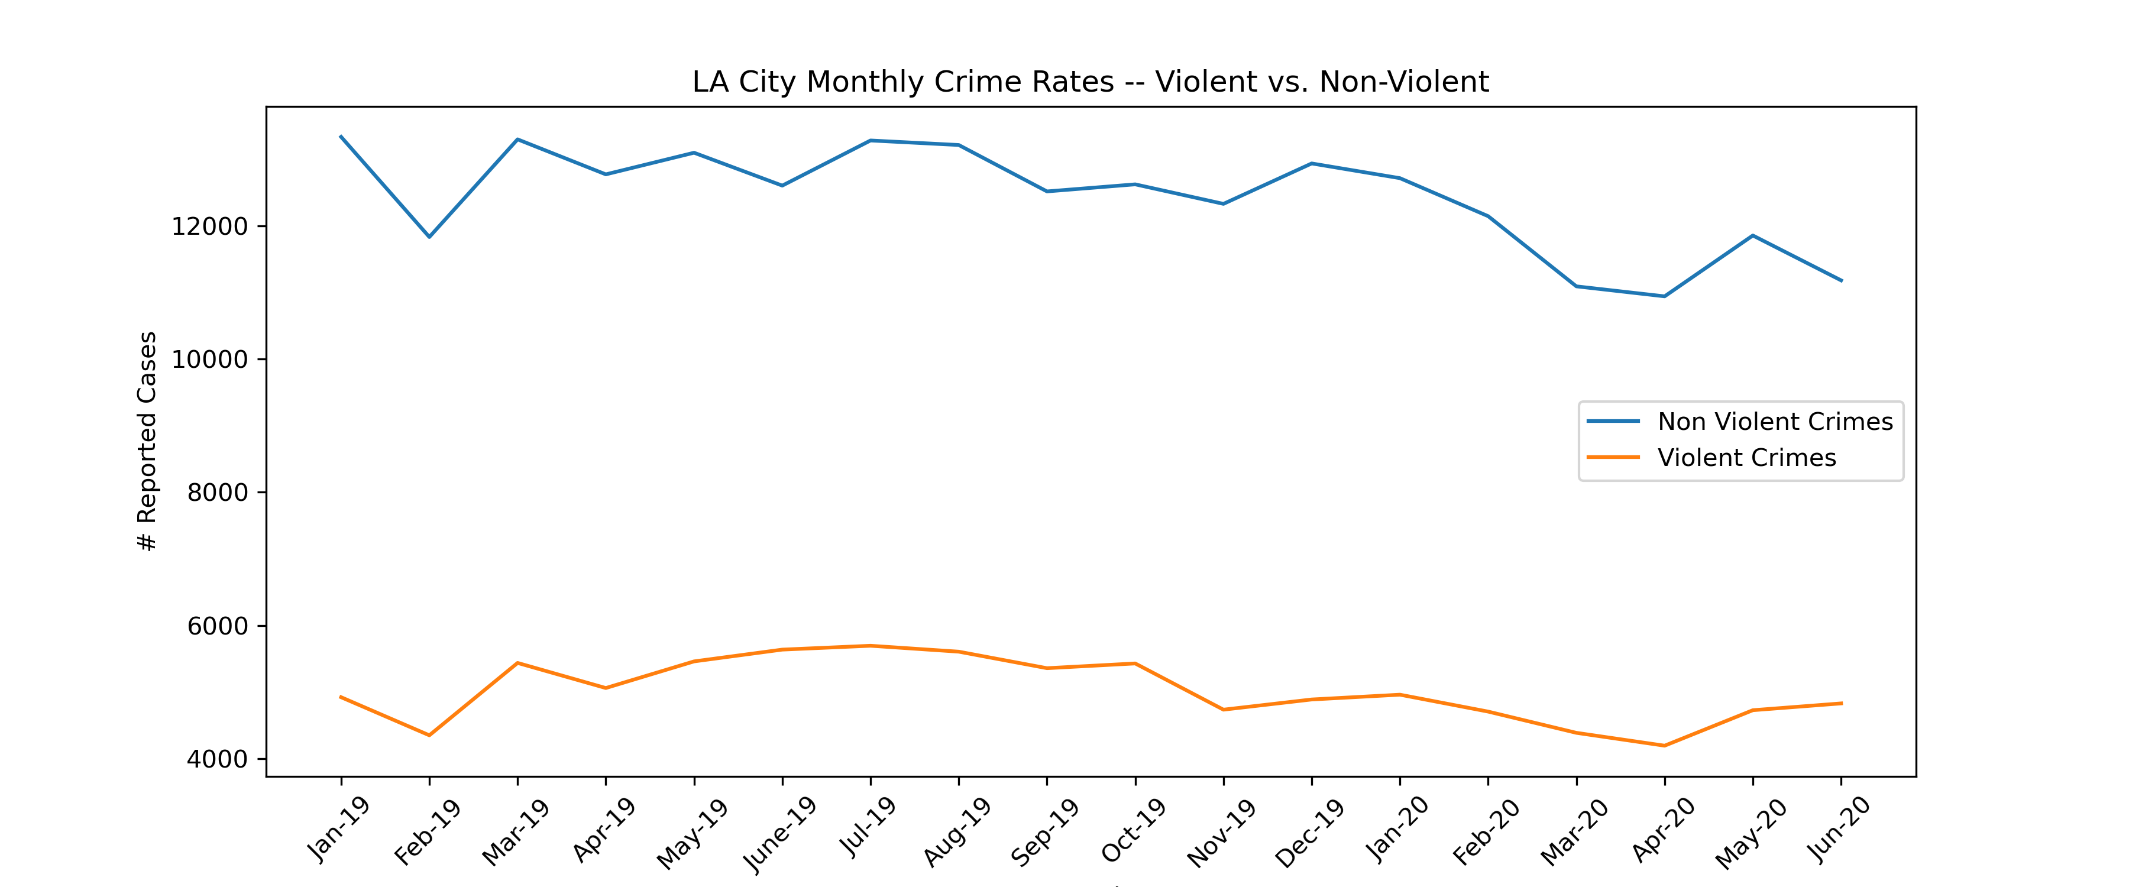
Los Angeles Crime Trends – Violent vs. Non-Violent
Los Angeles’ crime rates have generally been on a downward trend over the last 16 months
There was a small spike in both non-violent and violent crime beginning in the month of May
Non-violent crimes are still lower than the same period in 2019, while violent crimes are roughly equivalent to the same period last year

Slide 9
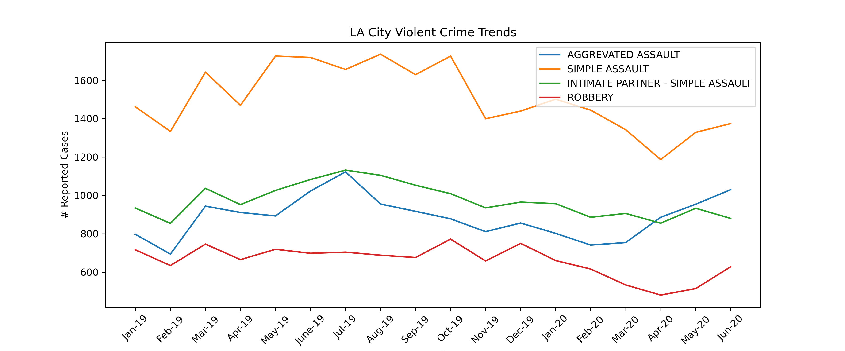
Los Angeles Crime Trends – Violent Crimes by Offense Type
All Violent crime offense types experienced a noticeable uptick in reported cases beginning in April 2020
However, due to the overall decline in Violent crime cases in the previous months, reported cases of major violent crimes were roughly in line with the same period last year
We don’t have enough data to determine whether there is a seasonal

Slide 10
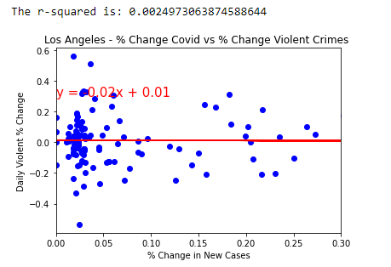
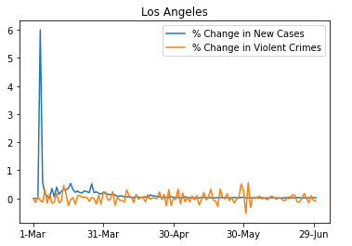
Los Angels Crime Correlation with COVID-19
The lack of correlation of Los Angeles’ reported crimes with reported COVID cases is consistent with the results we found across the entire city data set
If there were any correlation, we would have expected to see the results in Los Angeles, given that its reported COVID case counts were significantly higher than any other city in our study

Slide 11
Conclusions and Insights
Conclusions
Found no statistical correlation between the increase of Covid cases in the select major cities relative to violent or non-violent crime.
In the months where new Covid cases are increasing, there are trends of crime reduction
Believe this is based on city being on lock-down to reduce spread
Break in trend in May / June can be attributed to:
City relaxing lockdown measures during that time period
Large protests taking place during this period, as well
Potential Improvement in Study
It would be interesting to look at ten years of historical crime data for these cities to obtain statistical mean, median, and standard deviation, by month, to compare to the period of increasing Covid cases to determine if there is any significance
Other trends that may be observable over longer periods of time include seasonal changes and long-term changes in overall economic activity on crime rates by city

Slide 12
Appendix
Data on Selected Other Cities

Slide 13
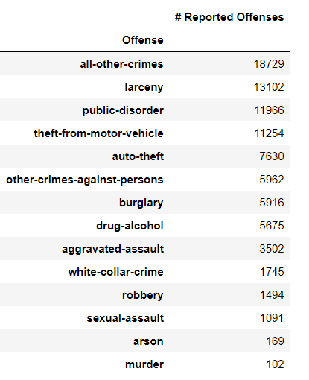
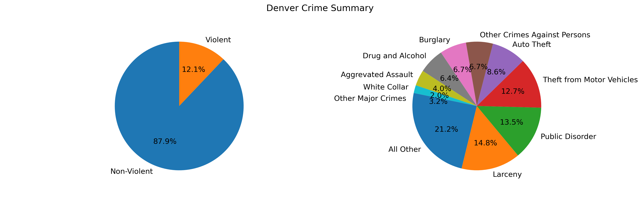
Denver – Overview of Crime by Offense
Source data and cleaning efforts
Source: www.denvergov.org
Data included traffic violations; our analysis adjusted the data to exclude traffic violations and focused on property crimes and crimes against the person
During the period of our analysis (Mar 1, 2019 through June 30, 2020), Denver experienced roughly 88,000 crimes, or 181 crimes per day

Slide 14
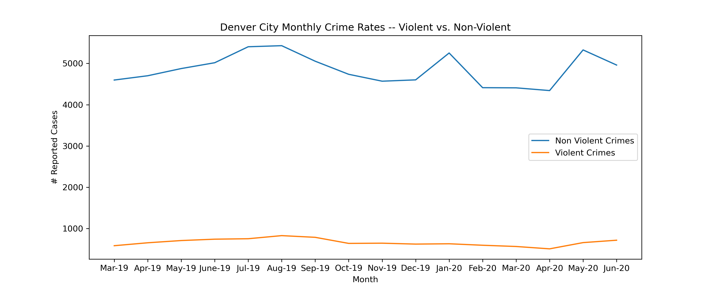
Denver Crime Trends – Violent vs. Non-Violent
Denver’s crime rates have been relatively flat over the last 16 months, although we would note a general decline in crime beginning in August 2019 before increasing in April of 2020
While this does not appear to be seasonal, we don’t have enough data to confirm this trends and would note that given Denver’s climate, more crimes may occur in the spring and summer seasons when the weather is warmer and more people are active and outdoors
The team also notes the relatively high increase in non-violent crimes during May 2020, which was the highest monthly increase during the period studied

Slide 15
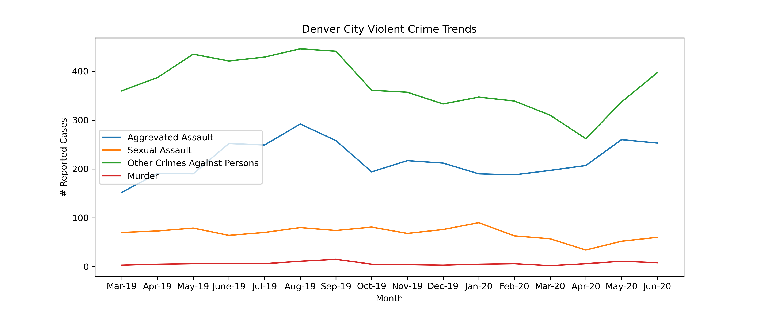
Denver Crime Trends – Violent Crimes by Offense Type
All Violent crime offense types – Aggravated and Sexual Assault, Other Crimes Against Persons, and Murder – experienced an uptick in reported cases in May 2020
However, overall Violent crime cases were in line with the same period last year

Slide 16
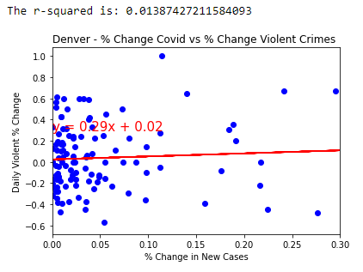
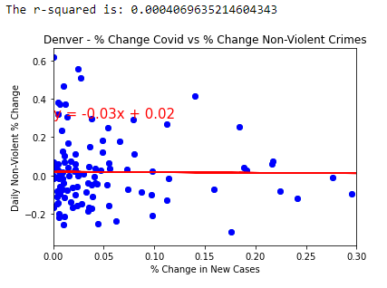
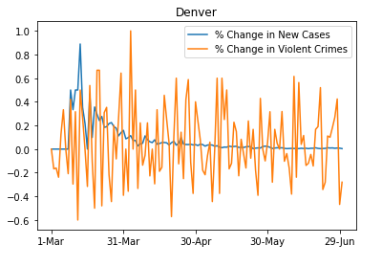
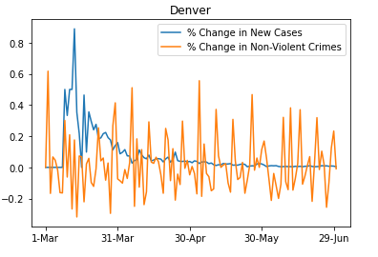
Denver Crime Trends vs. Reported COVID Cases

Slide 17
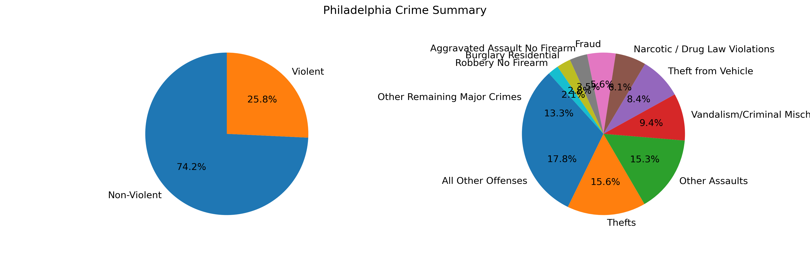
Philadelphia – Overview of Crime by Offense
Source data and cleaning efforts
Source:
[Data included traffic violations; our analysis adjusted the data to exclude traffic violations and focused on property crimes and criemes against the person]
During the period of our analysis (Mar 1, 2019 through June 30, 2020), Denver experienced roughly 88,000 crimes, or 181 crimes per dayCommentary on Denver Crime Stats

Slide 18
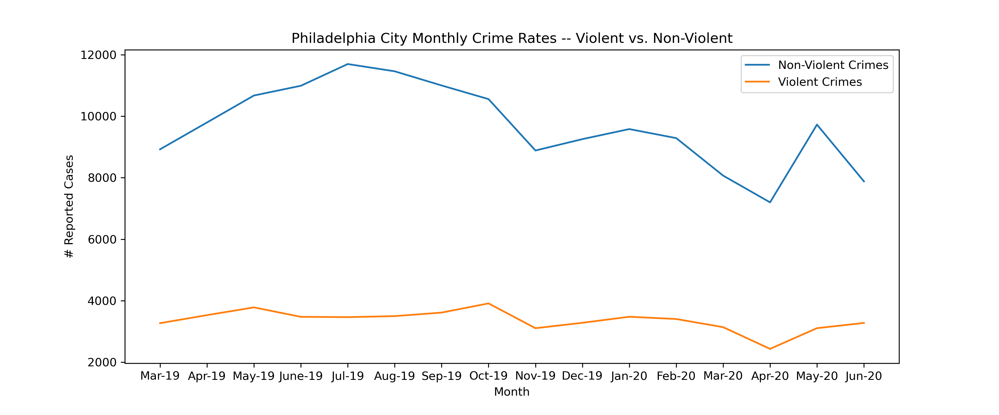
Philadelphia Crime Trends – Violent vs. Non-Violent
Denver’s crime rates have been relatively flat over the last 16 months, although we would note a general decline in crime beginning in August 2019 before increasing in April of 2020
While this does not appear to be seasonal, we don’t have enough data to confirm this trends and would note that given Denver’s climate, more crimes may occur in the spring and summer seasons when the weather is warmer and more people are active and outdoors
The team also notes the relatively high increase in non-violent crimes during May 2020, which was the highest monthly increase during the period studied

Slide 19
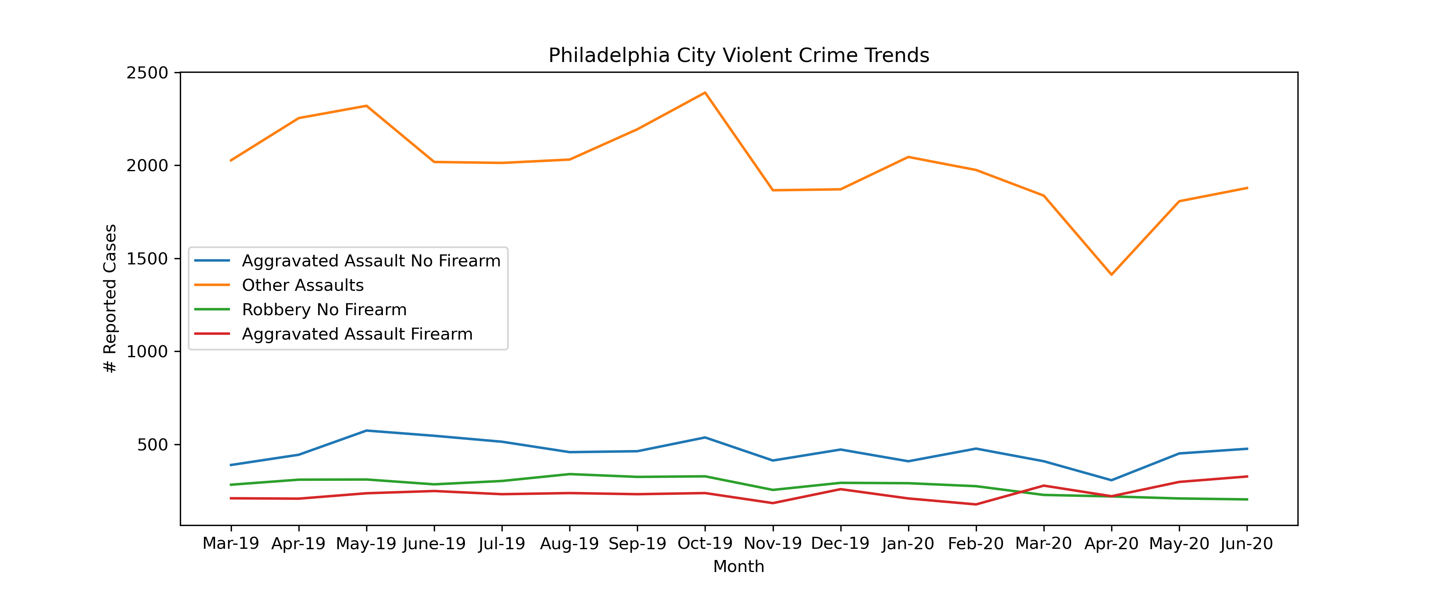
Philadelphia Crime Trends – Violent Crimes by Offense Type
All Violent crime offense types – Aggrevated and Sexaul Assault, Other Crimes Against Persons, and Murder – experienced an uptick in reported cases in May 2020
However, overall Violent crime cases were in line with the same period last year

Slide 20
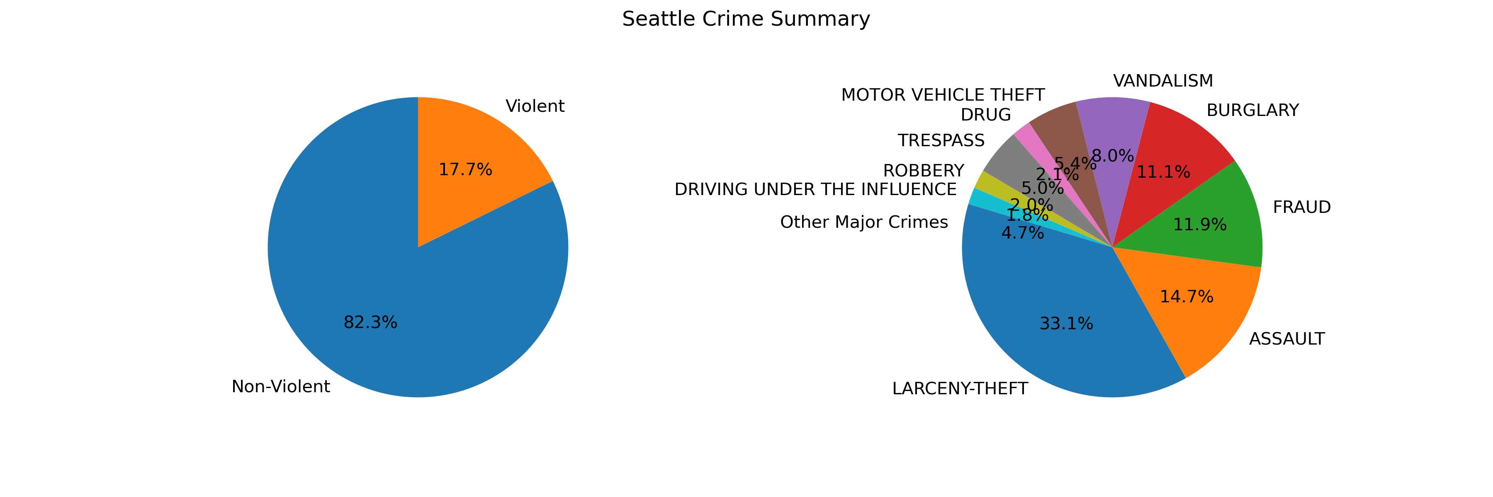
Seattle– Overview of Crime by Offense
Source data and cleaning efforts
Source:
[Data included traffic violations; our analysis adjusted the data to exclude traffic violations and focused on property crimes and criemes against the person]
During the period of our analysis (Mar 1, 2019 through June 30, 2020), Denver experienced roughly 88,000 crimes, or 181 crimes per dayCommentary on Denver Crime Stats

Slide 21
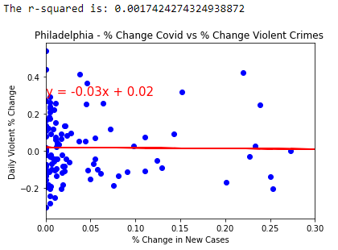
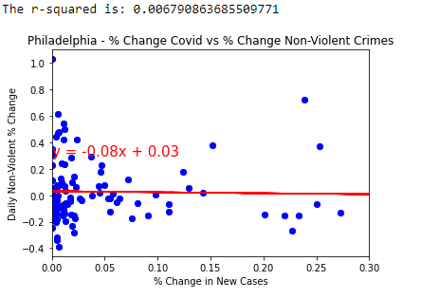
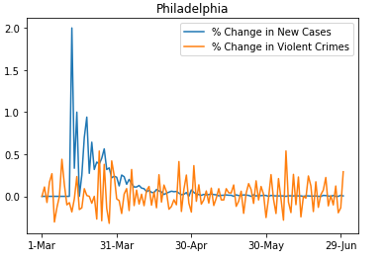
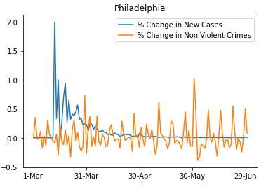
Philadelphia Crime Trends vs. Reported COVID Cases

